Slide 1
QUICK SORT
Instructor: Javeria Naz

Slide 2
Quick Sort
Like Merge Sort, Quick Sort is a Divide and Conquer algorithm.
It picks an element as pivot and partitions the given array around the picked pivot.
There are many different versions of quickSort that pick pivot in different ways.
Always pick first element as pivot.
Always pick last element as pivot
Pick a random element as pivot.
Pick median as pivot.

Slide 3
Cont.
The key process in quickSort is partition().
Target of partitions is, given an array and an element x of array as pivot, put x at its correct position in sorted array and put all smaller elements (smaller than x) before x, and put all greater elements (greater than x) after x.
All this should be done in linear time.

Slide 4
Cont.
The array is reordered or rearranged.
All the values smaller than pivot are moved to the left side of pivot element and all the values greater than the pivot are moved to the right side of pivot
element (with values equal to the pivot. going either side).
The array is logically divided into two sub-arrays.
In this step, data stored in an array is read (or examined) from left side and then right side at a time and then moved to the proper sides of pivot element.
In this process, two pointers work together, namely L (for left marker) and R (for right marker).
At the beginning of partition, L points to the first element of the array and R points to the last
element of the array. pointer L moves forward, while the pointer R moves backward.

Slide 5
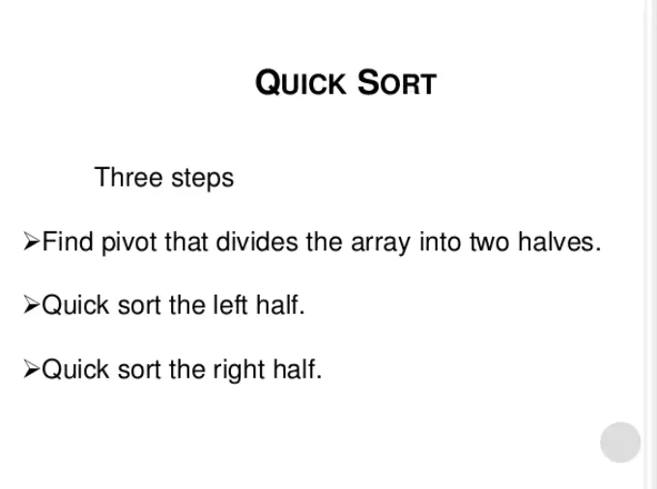

Slide 6
Quick sort algorithm
In Quick sort algorithm, partitioning of the list is performed using following steps:
Step 1 - START
Step 2 - Consider the first element of the list as pivot (i.e., Element at first position in the list).
Step 3 - Define two variables i and j. Set i and j to first and last elements of the list respectively.
Step 4- Increment i until list[i] > pivot then stop.
Step 5 - Decrement j until list[j] < pivot then stop.
Step 6 - If i < j then exchange list[i] and list[j].
Step 7 - Repeat steps 3,4 & 5 until i > j.
Step 8 - Exchange the pivot element with list[j] element.
Step 9 - END

Slide 7
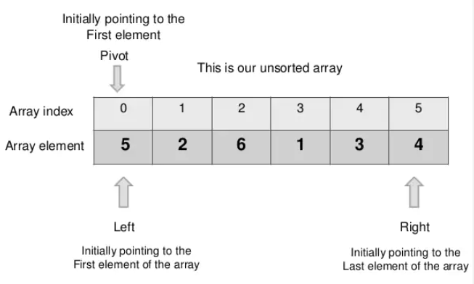

Slide 8
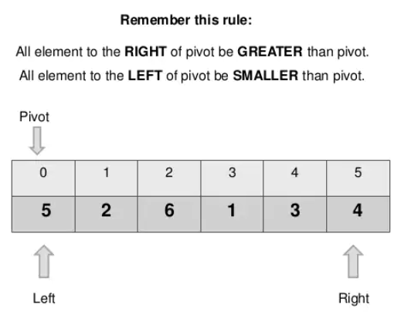

Slide 9
Quick sort properties
based on divide and Conquer design paradigm
Recursive algorithm
Time complexity
O(nlogn) → best and average case.
O(n^2) → worst case
Notes:
Divide the problem into sub problems and then from solution to subproblems we construct solution to actual problem.

Slide 10
Quick sort
Divide:
If a given array A has zero or one element, simply return; it is already sorted. Otherwise, split A[p .. r] into two subarrays A[p .. q-1] and A[q + 1 .. r], each containing about half of the elements of A[p .. r]. That is, q is the halfway point of A[p .. r].
Conquer Step
Conquer by recursively sorting the two subarrays A[p .. q] and A[q + 1 .. r].
Notes:
Divide the problem into sub problems and then from solution to subproblems we construct solution to actual problem.

Slide 11
Time complexity of quick sort
QuickSort (A,p,r) {
if(p<r) {
q= Partition (A,p,r); O(n)
QuickSort (A,p,q-1); T(n/2)
QuickSort (A,q+1,r); T(n/2)
}
T(n)= 2* T(n/2) + O(n) ---- using theorem
= Omega(nlogn) -- best case
Notes:
Whatever is the input either sorted, unsorted or random nos it always take O(n). Reason j always goes from start to n-1
If the partition function is dividing the array into equal halves- that is best case.
Q- The median of n elements can be found in O(n) time. What will be complexity of Quicksort in which median is selected as pivot.

Slide 12
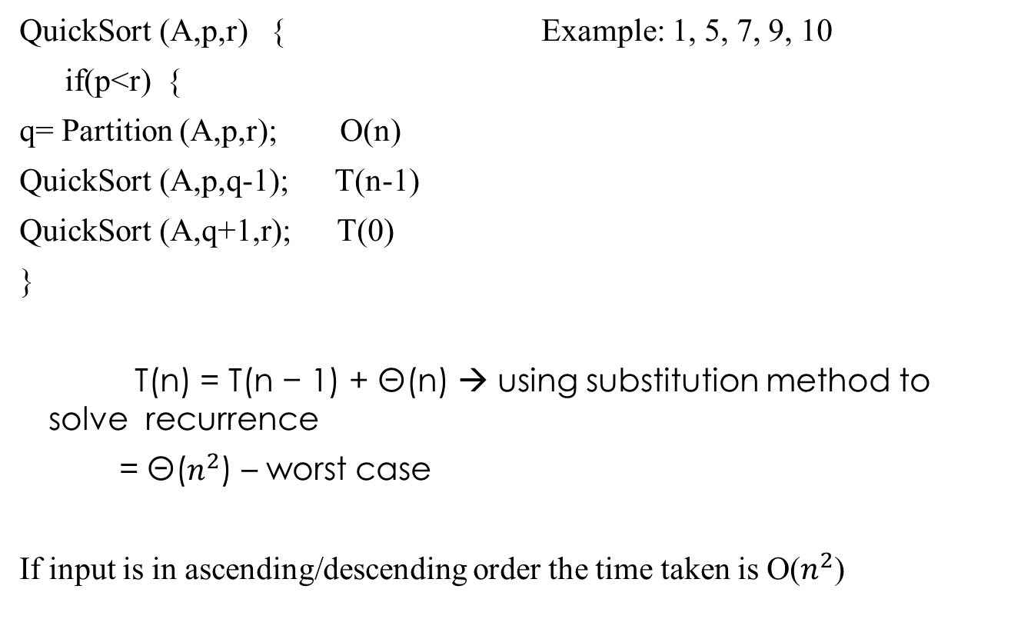
Time complexity of quick sort
QuickSort (A,p,r) { Example: 1, 5, 7, 9, 10
if(p<r) {
q= Partition (A,p,r); O(n)
QuickSort (A,p,q-1); T(n-1)
QuickSort (A,q+1,r); T(0)
}
T(n) = T(n − 1) + Θ(n) → using substitution method to solve recurrence
= Θ($n^{2}$) – worst case
If input is in ascending/descending order the time taken is O($n^{2}$)
Notes:
Or array contains all nos which are equal.

Slide 13
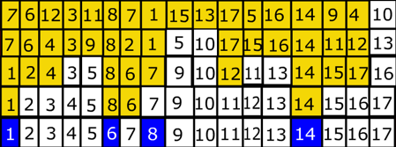
Example Quick Sort

Slide 15


Slide 16


Slide 17


Slide 18


Slide 19
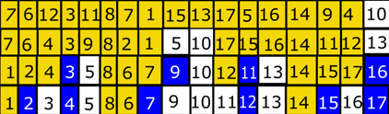

Slide 20
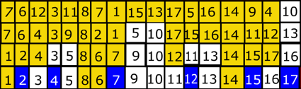

Slide 21
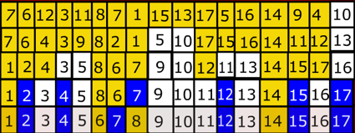

Slide 22
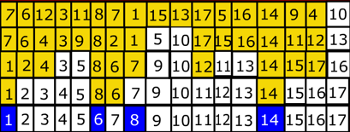

Slide 23
Shell sort
Shell sort method was discovered by Donald Shell in 1959. It is named in the honour of its inventor.
It is also known as Shell's method and is one of the oldest sorting method.
It is an improved form of insertion sort method (or variation of insertion sort).
It works by comparing elements that are certain distance away from each other (i.e. separated by a gap of different positions) rather than adjacent elements in the array.
It sorts the array or list in different phases or passes.

Slide 24
Shell sort (Cont.)
The distance or gap size decreases in each phase until the gap reaches 1. Thus in the last phase, the adjacent elements are compared.
It means that Shell sort works as insertion sort in last phase. Please note that in insertion sort the gap between comparing elements is 1.
Therefore, if gap = 1, then Shell sort method becomes like insertion sort method.
The running time of Shell sort is dependent on the gap sequence it uses.
Shell sort is an in-place sorting method as it requires no additional space in y during execution.
It is fast, easy to understand and easy to implement as faster than bubble sort and twice faster than insertion sort.
However, its complexity analysis tells us that it is a complicated.

Slide 25
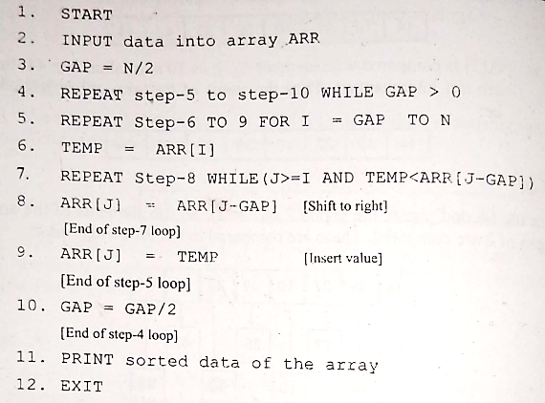
Algorithm

Slide 26
Time Complexity
Worst Case Complexity: less than or equal to O( n² )
Best Case Complexity: O(n*log n)
Average Case Complexity: O(n*log n)

Slide 27
Determining Gap
The fundamental problem of Shell sort is to determine the optimal gap between compared elements.
Donald Shell proposed an initial gap of size " n/2 " where " n " is the size of the array.
The initial gap is divided by 2 in each phase until the gap becomes 1.
This approach has one major disadvantage that elements at odd and even positions of array are mutually compared only in the last step.

Slide 28
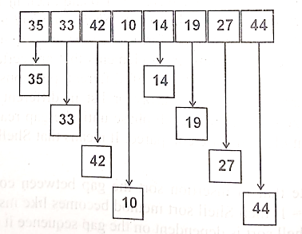
Example
Phase-1:
In the first phase, the gap is 4. So the elements of array with gap of 4 at compared. These are compared in the following order:
A[o] is compared with element A[4]: as 35 is greater than 14 they are interchanged. The new status of the array will be:
14 | 33 | 42 | 10 | 35 | 19 | 27 | 44

Slide 29
A[1] is compared with element A[5]: as 33 is greater than 19 they are interchanged. The new status of the array will be:
A[2] is compared with element A[6]: as 42 is greater than 27 they are interchanged. The new status of the array will be:
A[3] is compared with element A[7]: as 10 is greater than 44 they are not interchanged. The new status of the array will be:
14 | 19 | 42 | 10 | 35 | 33 | 27 | 44
14 | 19 | 27 | 10 | 35 | 33 | 42 | 44
14 | 19 | 27 | 10 | 35 | 33 | 42 | 44

Slide 30
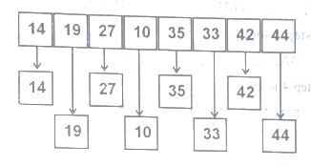
Example
Phase-2: In the first phase, the gap is 4/2=2. So the elements of array with gap of 2 at compared. These are compared in the following order:
Compare A[0] with A[2] they are arranged so they are not interchanged. Similarly, A[4] with A[6] they are arranged so they are not interchanged.
Compare A[0] with A[2] they are arranged so they are not interchanged. Similarly, A[4] with A[6] they are arranged so they are not interchanged.
14 | 19 | 27 | 10 | 35 | 33 | 42 | 44
14 | 10 | 27 | 19 | 35 | 33 | 42 | 44

Slide 31
Phase-3: In the second phase, the gap is “2”, (2/2=1). So the elements of array with gap of “1” at compared. These are compared in same way as insertion sort.
10 | 14 | 19 | 27 | 33 | 3 | 42 | 44

Slide 32
Practice Question
Sort the following array by using Shell Sort.
A[0] | A]1] | A[2] | A[3] | A[4] | A[5] | A[6] | A[7]
50 | 14 | 29 | 27 | 3 | 63 | 92 | 6

Slide 33
Radix Sort
Radix sort is the fastest sorting method.
It is used for sorting large integers and strings.
It treats an integer as a string of digits and arranges the integers in order by comparing the digits of the integers.
Radix sort is a non-comparison sorting method because it does not compare the numbers but distributes them into different groups based on their digits significant digits i.e. least significant digit or most significant digit).
Therefore, Radix sort method comes under the category of distribution sort'.
It distributes data items to different buckets in the form of groups (buckets are storage area where data items with a common property are stored).

Slide 34
Radix Sort (Cont.)
Radix sort method sorts the list of items (numbers or strings) in different phase.
In first pass, numbers are distributed into groups based on the least significant digit.
Similarly, in second pass numbers are redistributed into groups based on the second least significant digit and so on.
After each pass, numbers are collected the buckets, keeping the numbers in order.
When the last pass is done, numbers ay are sorted. The number of passes or iterations is based on length of the highest individual number in the list.
Suppose the length of the highest number is 3 .. 254), then 3 passes are required for sorting the list of numbers using Radix sort method.

Slide 35
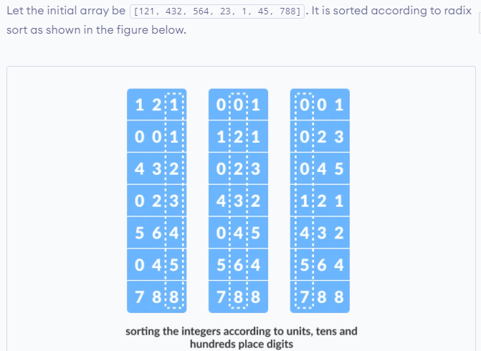

Slide 37
Bucket Sort
Bucket Sort is a sorting algorithm that divides the unsorted array elements into several groups called buckets.
Each bucket is then sorted by using any of the suitable sorting algorithms or recursively applying the same bucket algorithm.
Finally, the sorted buckets are combined to form a final sorted array.
Scatter Gather Approach
The process of bucket sort can be understood as a scatter-gather approach.
Here, elements are first scattered into buckets then the elements in each bucket are sorted.
Finally, the elements are gathered in order.

Slide 38
Algorithm
START
create N buckets each of which can hold a range of values
for all the buckets
initialize each bucket with 0 values
for all the buckets
put elements into buckets matching the range
for all the buckets
sort elements in each bucket
gather elements from each bucket
end bucketSort

Slide 39
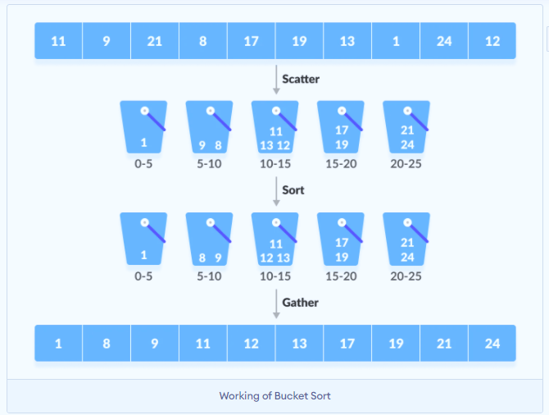
Working of bucket sort

Slide 40
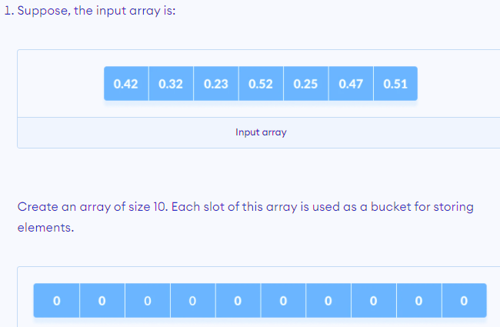
Example

Slide 41
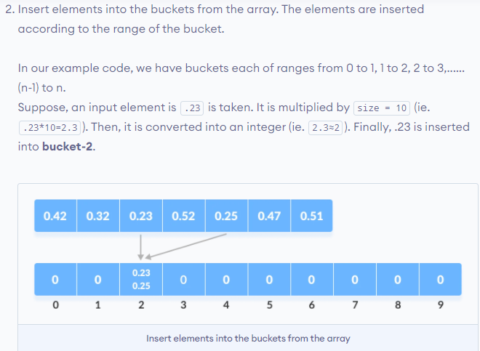
(Cont.)

Slide 42
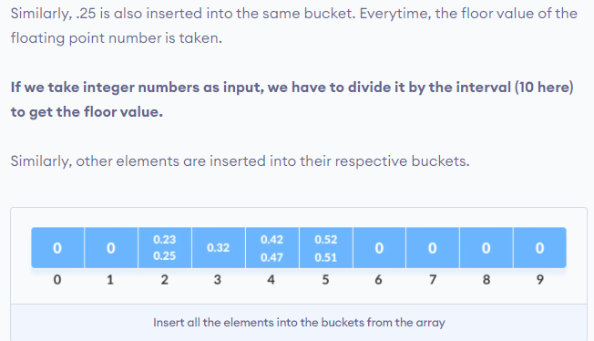
(Cont.)

Slide 43
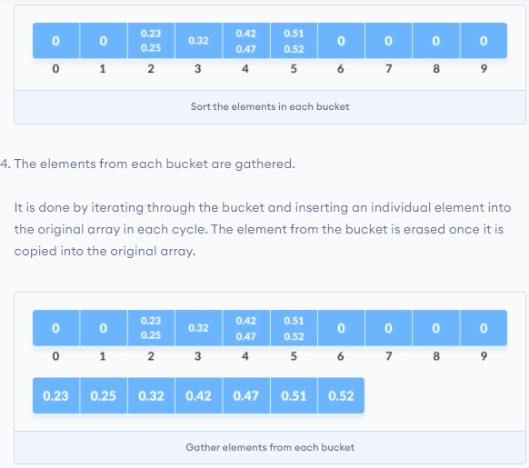
(Cont.)

Slide 44
Code
#include <iostream>
using namespace std;
int getMax(int a[], int n) // function to get maximum element from the given array
{
int max = a[0];
for (int i = 1; i < n; i++)
if (a[i] > max)
max = a[i];
return max;
}
void bucket(int a[], int n) // function to implement bucket sort
{
int max = getMax(a, n); //max is the maximum element of array
int bucket[max], i;
for (int i = 0; i <= max; i++)
{
bucket[i] = 0;
}
for (int i = 0; i < n; i++)
{
bucket[a[i]]++;
}
for (int i = 0, j = 0; i <= max; i++)
{
while (bucket[i] > 0)
{
a[j++] = i;
bucket[i]--;
}
}
}
void printArr(int a[], int n) // function to print array elements
{
for (int i = 0; i < n; ++i)
cout<<a[i]<<" ";
}
int main()
{
int a[] = {34, 42, 74, 57, 99, 84, 9, 5};
int n = sizeof(a) / sizeof(a[0]); // n is the size of array
cout<<"Before sorting array elements are - \n";
printArr(a, n);
bucket(a, n);
cout<<"\nAfter sorting array elements are - \n";
printArr(a, n);
}

Slide 45
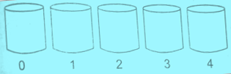
Example-2
Suppose array is:
Suppose buckets are 5 where these elements/numbers are to be distributed.
Search for the largest value to find the divider for distributing the values in buckets.
Here largest value is 81 so divider will be calculated as:
ceil((81+1)/5.0) = ceil (82/5.0) = 17
75 | 2 | 42 | 19 | 4 | 81 | 1

Slide 46
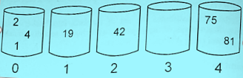
(Cont.)
Numbers are to be distributed as follows:
Number | Bucket | Description
75 | 4 | Floor(75/17)=4
2 | 0 | Floor(2/17)=0
42 | 2 | Floor(42/17)=2
19 | 1 | Floor(19/17)=1
4 | 0 | Floor(4/17)=0
81 | 4 | Floor(81/17)=4
1 | 0 | Floor(1/17)=0

Slide 47
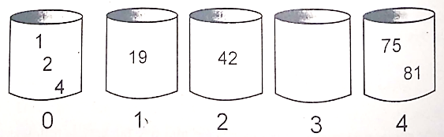
(Cont.)
Sorting numbers of bucket:
Each bucket is sorted individually.
Collecting numbers from each bucket in order:
Output will be the sorted array.
1 | 2 | 4 | 19 | 42 | 75 | 81

